Slide 1
PARENT EVENT
(School Name Here)

Slide 2

Session Goals
Provide an overview of HISD PowerUp initiative
Provide an overview of responsible use of technology

Slide 3
Why Now?
“With anytime – anywhere learning, our students will have the world at their fingertips. We will make sure they learn skills that complement technology in order to prevent them from being replaced by technology.”
Terry B. Grier, Ed.D.,
HISD Superintendent of Schools
February 1, 2013 | HISD State of the Schools Address

Slide 4
Why Now?
Our Vision: Becoming Great All Over means great opportunities for all students
With 24/7 access to information, students are at the center of the teaching and learning process
View videos, find educational sites from all over the world and work in projects to develop:
  Critical Thinking
  Communication
  Collaboration
  Creativity

Slide 5

Turn and Talk
What excites you about your child having a laptop at home for his or her learning?

Slide 6
The Right Thing?
    “This is more than just giving students laptops. This is about changing the way teachers teach and students learn. PowerUp will create transformational, digital-age instruction that will prepare Houston’s children to succeed in the 21st century and compete with their peers around the world.”
Lenny Schad,
Houston ISD Chief Technology Officer

Slide 7
21st Century Skills
Critical thinking and problem solving
Collaboration and leadership
Agility and adaptability
Initiative and entrepreneurship
Effective oral and written communication
Accessing and analyzing information
Curiosity and imagination

Slide 8



Getting to Know Your Child’s Device

Slide 9
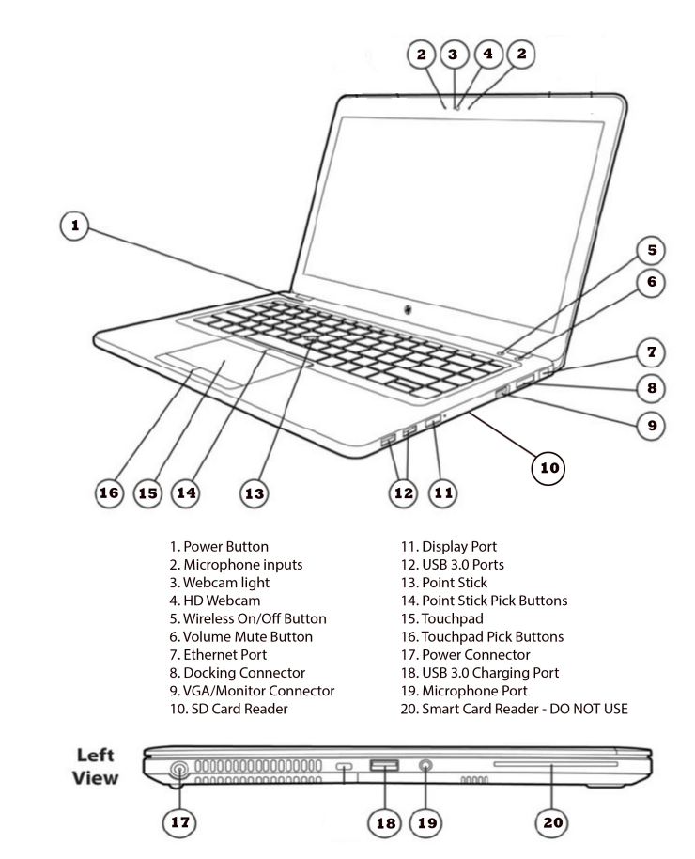
Device Features
Notes:
There are 20 main features, please make sure you are familiar with the essential items such as the power button and the charger.
Note: Consider using a teacher device to showcase a small number of features to make it more visual.

Slide 10
Software Installed
Office 2013
Software Center
Internet Explorer 9
Google Chrome
Adobe Acrobat Reader
Adobe Flash
Adobe Shockwave Player
QuickTime
Windows Media Player
Windows Movie Maker
Computrace
Antivirus
Notes:
Your child’s device comes equipped with a number of standard software programs to assist in their learning.
For example, Microsoft Office which will allow to use “Word” to write, create spreadsheets and power points.
In addition, your child will be able to make movies and access the internet at school.
If questions:
BlueCoat = filtering system to protect your child from inappropriate sites
Computrack “low jack” will allow us to find the device if it gets stolen
Other software that improve functions of “Rich Internet Applications”, for interactive media and webinars and secure remote desktop control (so technicians can see something is not working.)
Also, a “Software Center” for downloading approved applications

Slide 11
Software Available for Installation
7-Zip 9.20
Google Earth
iTunes
Skype 6.7
Smart Education Software
Notes:
These software programs are available for downloading, if the teacher needs them

Slide 12
Laptop Care
Use school-issued bag (with name on removable label)
Walk with lid closed, never open
Keep laptop away from food and drinks
Do not leave laptop unattended, especially in a car (not even in the trunk, it can overheat!)
Bring charged laptop to school daily
Notes:
Please read over the rules for caring for your laptop. If they have any additional questions contact your child’s teacher.

Slide 13

How to Keep Your Child Safe
Notes:
Safety is our main priority. I’m going to walk you through a few information items and rules designed to protect your child.

Slide 14
Internet Safety at School
During school hours, students use the Internet only for education and research purposes
Teachers monitor student Internet use in class
Students are not allowed “free time” to search the Internet
Students receive training on use of laptop and Internet safety

Slide 15
Safety for Your Child
NEVER give out personal information
NEVER use parent’s credit card without permission
NEVER share passwords with anyone
(other than your parents)
NEVER arrange a face-to-face meeting
with someone you met online
DO NOT OPEN an email if you do not know who sent it
DO NOT CLICK on banner ads or pop up ads on websites
NEVER USE bad language or send threatening email
Notes:
Please review these safety don’ts with your child before they start using their laptops.
These rules are non-negotiable and are designed to protect your child’s safety.

Slide 16
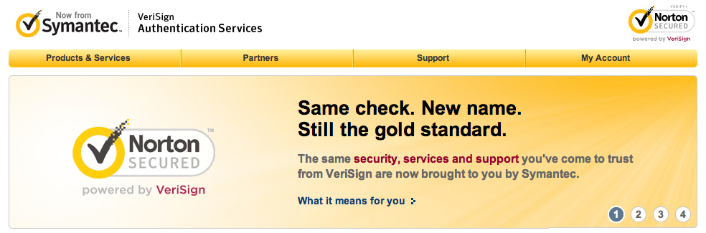
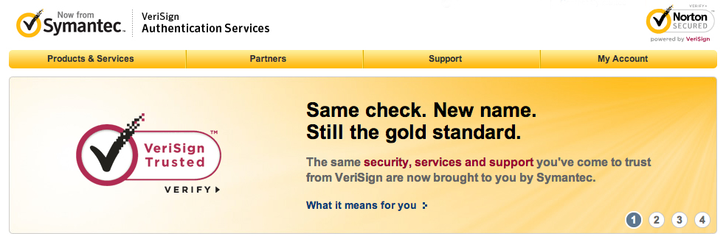
Using Credit Cards Online
VeriSign is a way to transmit highly secure transactions
The symbol means the merchant meets security standards
Adapted from: “11 Tips for Safe Online Shopping” by Eric Griffith, PC Mag.com, Nov. 21, 2011
Notes:
Other advice you can add:
Use familiar sites
Look for the lock in the address bar
Don’t tell all
Check statements
Use strong passwords
Avoid public computers
Don’t use while in a pulic Wi-Fi
Know what deals are too good to be true

Slide 17
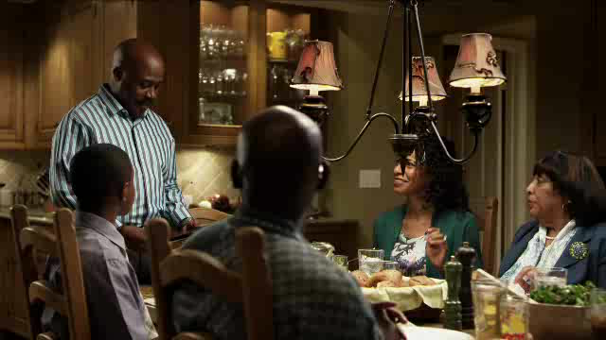
What is at stake?
If you would not share it with your family, DO NOT post it!

Slide 18
The 10 Common Sense Rules for Parents
Model good behavior
Pay attention
Share your values
Establish limits
Encourage balanced lives
Make kids accountable
Discuss what is at stake
Find ways to say “yes”
It’s not rocket science
Lighten up and enjoy
Notes:
Commonsensemedia.org is a great place to find advice for parents.
Please review these safety don’ts with your child before they start using their laptops.
These rules are non-negotiable and are designed to protect your child’s safety:
Model good behavior: put your own cell phone away during family time
Pay attention to what your child is doing while in front of the computer, what sites they visit, with whom they are communicating. Ask them to use the computer in a common room, not behind closed doors. Ask and know your child’s passwords, monitor any social media sites they frequent to make sure they are safe and check the browser history. If the history is empty, ask your child why.
Share your values with your child: discuss cheating, lying, being cool, piracy
Establish limits: limit computer and cell phone time
Encourage balanced lives; balance computer time and internet games with outdoor play, sports, reading, visiting with friends and family
Make kids accountable: cell phones and internet are a privilege. Teach your child to be responsible in how they use them. If they abuse them, there should be consequences. Stick to your rules.
Discuss what is at stake: Once a picture, video or words are posted in the web, they can never be retrieved. Millions of people can potentially see them, or read them.
Find ways to say “yes”. Find fun sites and tools
It’s not rocket science. Ask your child to teach you, discuss this with other parents or your children’s teacher(s)
Lighten up and enjoy, embrace your children’s world

Slide 19
School Internet Filtering
Filtering software installed on Houston ISD web server blocks social media and other prohibited sites.
  Filter is in place at all times, even when at home
Blocks websites based on content key words
Can block specific websites upon request
Notes:
This laptop is installed with software to prevent access to inappropriate sites.

Slide 20


Communication Tools
The district will provide Edmodo and Office 365 accounts for students communicating with their teachers, collaborating with other students in their class and submitting assignments.
Students will learn about copyright laws, intellectual property and privacy
Notes:
Once your child is using these tools we encourage you to ask your child to demonstrate their use.

Slide 21
Parent Student Connect
Have an account
Actively monitor it
Set up triggers

Slide 22
Social Media
MONITOR all social media use
Houston ISD filters block unsafe sites
Be aware of which social media sites your child is using
Talk with your child about their digital footprint
Be alert of any cyber-bullying and notify school immediately if it involves another student
Notes:
Although these social media programs are NOT available on your child’s laptop you parents should monitor social media use.
Houston ISD filters block unsafe sites, but students can access them through their smartphones.
It’s really about being a good citizen in the real world or on the internet.
Be aware of which social media sites your child is using (Twitter, Vine, Facebook, Instagram, SnapChat, Tumblr etc.)
Talk with your child about their permanent digital footprint (digital footprint is any and all information about a person in the internet)
Be alert of any cyber-bullying and notify school immediately if it involves another student
Examples of social media
Twitter
Facebook
Linkedin
Foursquare
YouTube
Instagram
Pinterest
Google Plus
Last.fm

Slide 23

Turn and Talk
Jot down the most important safety tidbit on a post-it.
Place it in one of the papers labeled “Safety Tidbit”.
Share with a parent seated next to you.

Slide 24
Responsible Use of Technology
Follow copyright laws (music piracy)
Use appropriate language online
Students will make available all messages or files upon administrator or teacher request
Like a textbook or a locker, Houston ISD owns the laptop. Students are only permitted to use it for educational advancement
Administrators have the capability to remotely view student computers
Notes:
What is “responsible use of technology? It is the rules to follow and the etiquette, to follow the law and to avoid hurting others in the internet.
We expect our students to follow the same code of conduct on the internet as we they do in the classroom.

Slide 25

What is Prohibited?
Bypassing the filter
Using another student’s username or password
Sharing passwords (other than with parents)
Downloading or installing software that has not been approved
Tampering with hardware
Chat rooms, IM, social networking, hosting in non-school approved web pages
Inappropriate material:
Unacceptable in a school setting
Notes:
Improper use of technology will result in consequences such as discipline, detention and or limited use of their device.
These are common sense rules to respect others and HISD property. Please refer to your campus’s code of conduct.

Slide 26
Q&A
?
In the index card provided to you, please write down comments or questions you have.
We will like to send you a survey to see if this information was helpful to you and your child.
Notes:
Explain that we would like to send them Survey Monkey link, about 1 month after their children receive the devices, to find out
If the information we gave you today was helpful to you (so you can support your child’s education)
Find our if there are challenges that we need to consider to support your child, teacher or you

Slide 27
Technology Resources for Parents
http://www.houstonisd.org/Page/66660
http://houstonisd.org/instructionaltech
http://ftc.gov

Slide 28
Discounted Internet and Free Wifi
Xfinity Internet connection $9.95 for eligible families:
http://www.InternetBasico.com
1-855-765-6995 (Español)
http://www.InternetEssentials.com
1-855-846-8376 (English)
Free Wifi around the city:
WeCan Houston - Community Wifi Networks: http://digitalhouston.ning.com/Services

Slide 29
TRANSFORMING TEACHING AND LEARNING
Becoming #GreatAllOver

